Slide 1
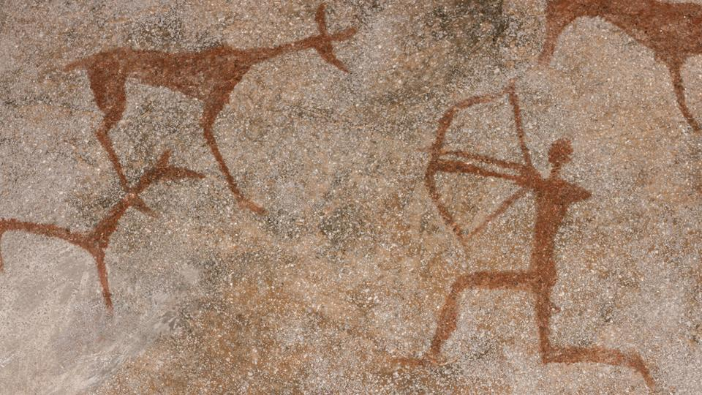
Cave Painting in Arizona

Slide 2
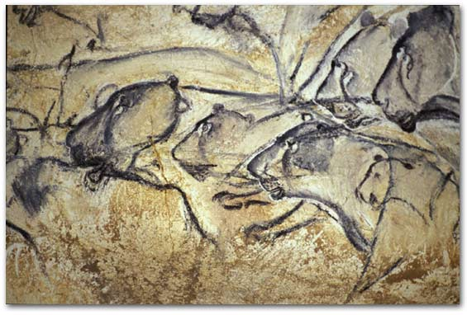
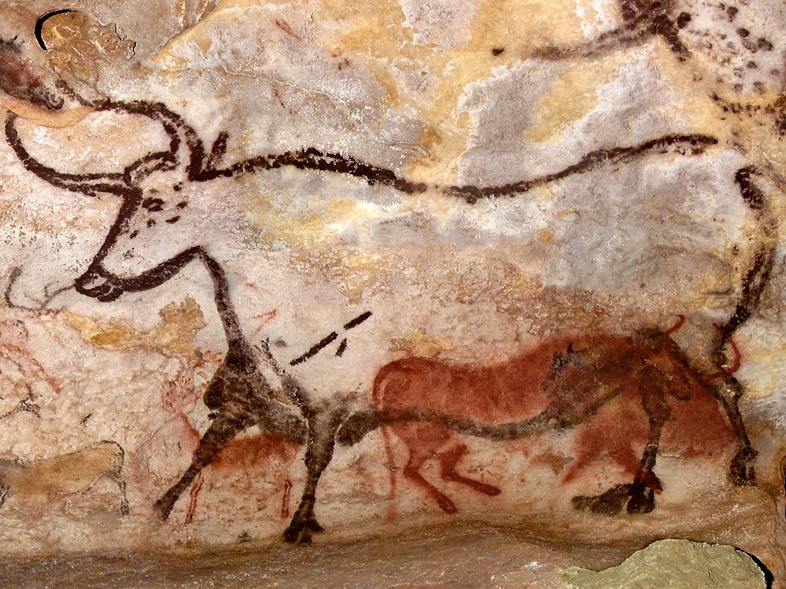
What are cave paintings or cave art?
Pictures drawn or carved on the walls or ceilings of caves
Most of the pictures are of animals like deer, horses, mammoths, lions

Slide 3
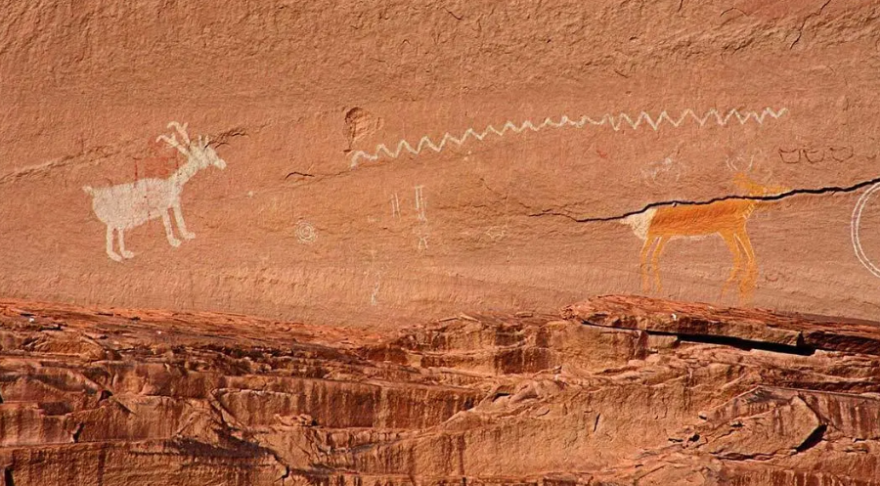

Slide 4
How did people make the art?
Mostly created with red or black colors made from rocks or engraved (carved) into the rocks

Slide 5
Sometimes, instead of paint, they used rocks as tools to carve into the cave walls!

Slide 6
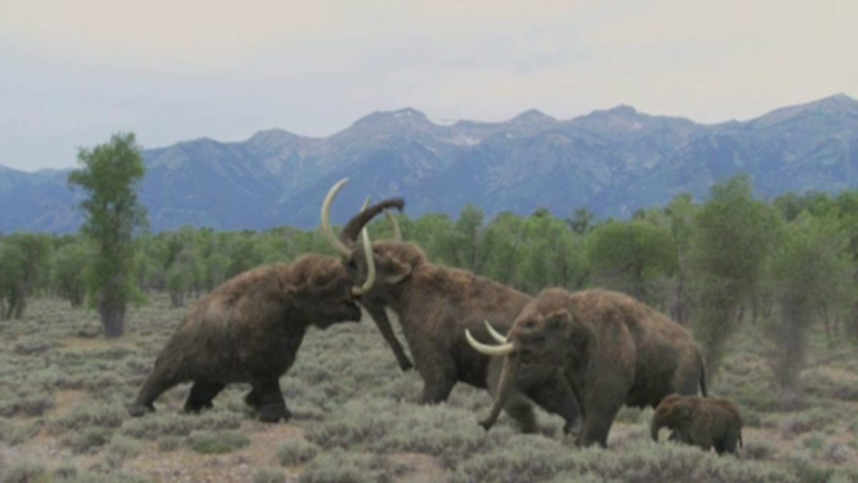
When did people paint on cave walls and ceilings?
Most pictures date between 10,000 and 40,000 years old
Mammoths roamed the earth!

Slide 7
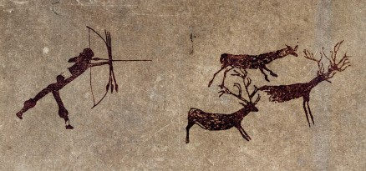
Why did they make cave art?
Hunting was important to get food. A lot of the art found in caves is about hunting.
Why would you draw about something that you do every day?

Slide 8
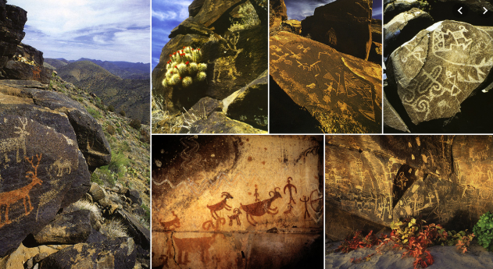

Slide 9
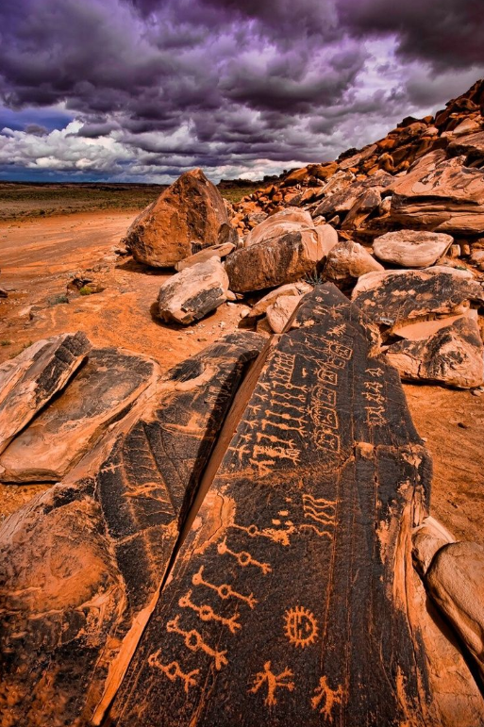
Where do you find cave paintings?
Mostly in Europe (France and Spain)
You can find cave art in Arizona too!
Petrified National Park
Near Sedona
Saguaro National Park
Northern AZ in the Navajo Nation
Have you been to any of these places?

Slide 10
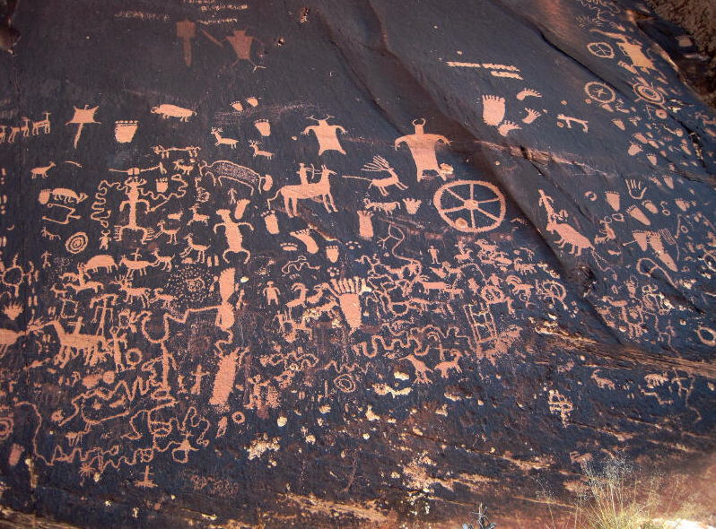

Slide 11
