Slide 1
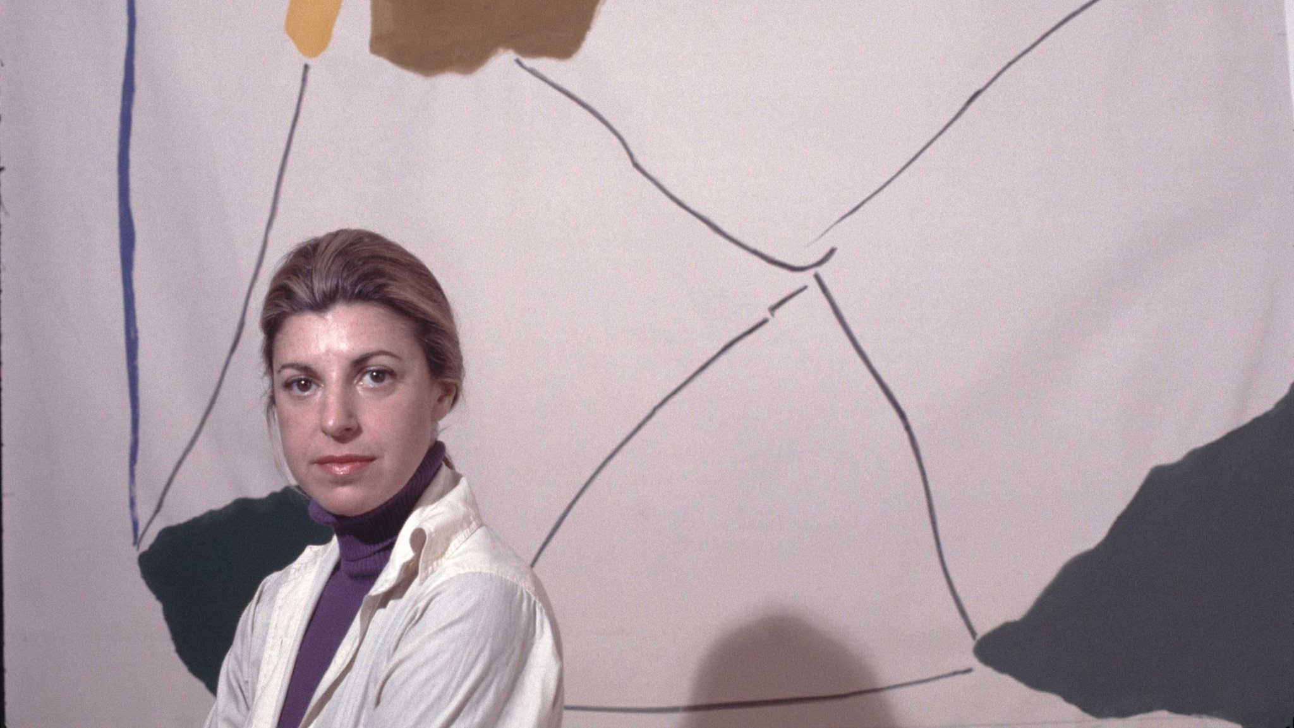
Helen Frankenthaler
American Painter
1928-2011

Slide 2
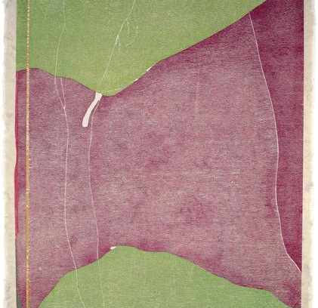
Biography
Style
Famous Works

Slide 3
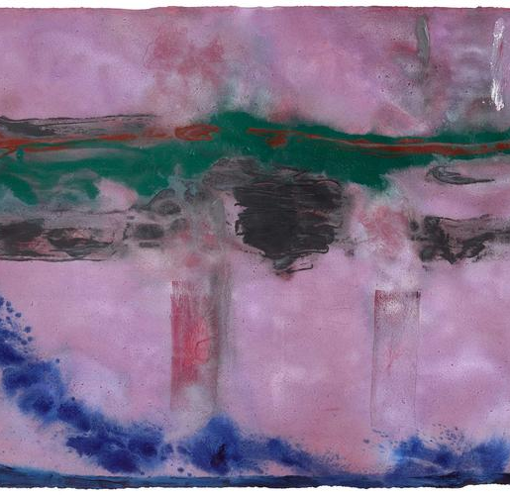
Biography
Frankenthaler was born on December 12, 1928
She was raised in New York City
In 1949 she graduated from Bennington College, Vermont.
Frankenthaler’s professional exhibition career began in 1950, when Adolph Gottlieb selected her painting Beach (1950) for inclusion in the exhibition
Her first solo exhibition was presented in 1951
She had her first major museum exhibition in 1960, at New York’s Jewish Museum
Her second, in 1969, at the Whitney Museum of American Art
Followed by an international tour.

Slide 4
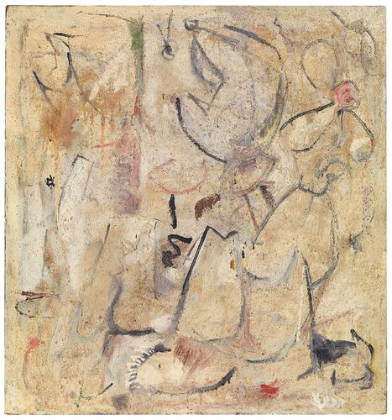
Beach - 1950
Oil, sand, plaster of Paris, and coffee grounds on sized, primed canvas

Slide 5
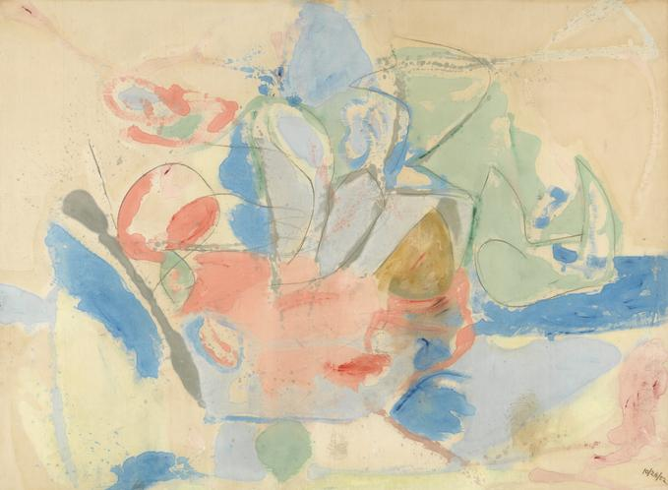
Mountain and Sea
In 1952 a “breakthrough” painting of American abstraction for which she poured thinned paint directly onto raw, unprimed canvas laid on the studio floor, working from all sides to create floating fields of translucent color.

Slide 6
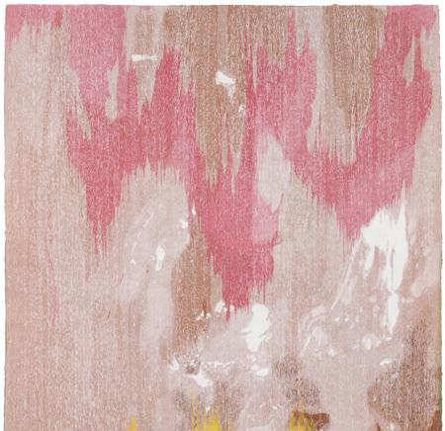
Her Style
She was a postwar American abstract painter and contemporary artist
Widely credited for playing a pivotal role in the transition from Abstract Expressionism to Color Field painting
Invented the soak-stain technique (This technique involved using thinned-down paint to create abstract paintings so oil paints looked like watercolor!)
Referenced figures and landscape in unique ways
In addition to producing unique paintings on canvas and paper, she worked in a wide range of media, including ceramics, sculpture, tapestry, and especially printmaking.

Slide 7
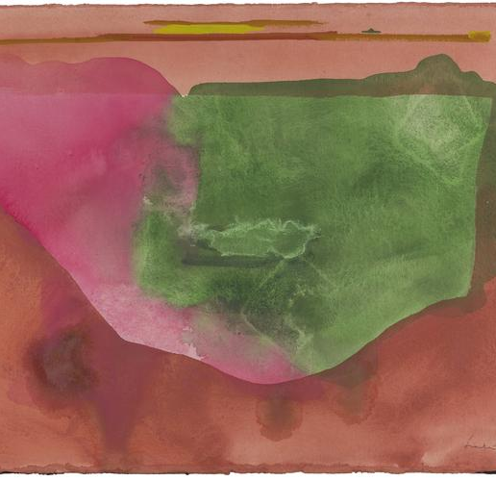
Color Field
Color field painting is a style of abstract painting that emerged in New York City during the 1940s and 1950s.
It was inspired by European modernism (Modernism was a cultural movement which spread across Europe in the 19th and 20th centuries.)
It is difficult to define, but generally it was viewed as a move towards change.
Focused on freedom and expression.
Despite its often chaotic and spontaneous appearance, it possesses a structure that is composed of six key elements: color, shape, form, texture, line, and value)

Slide 8
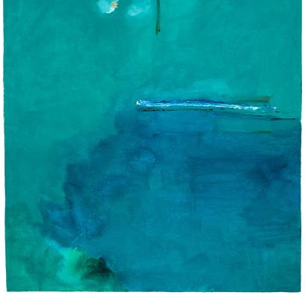
What is Color Field?
Color field is characterized primarily by large fields of flat, solid color spread across or stained into the canvas creating areas of unbroken surface and a flat picture plane.
The movement places less emphasis on gesture, brushstrokes and action in favor of an overall consistency of form and process.
“A really good picture looks as if it's happened at once. It's an immediate image.” Frankenthaler

Slide 9
Questions:
What do you notice about the colors?
What shapes/forms do you see?
What do each of the paintings make you think of?
How do you feel when you look at her art?

Slide 10
Abstract Landscape, 1951

Slide 11
Before the Caves, 1951

Slide 12
Cool Summer, 1962

Slide 13
The Bay, 1963

Slide 14
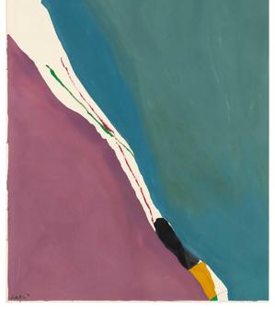

Slide 15
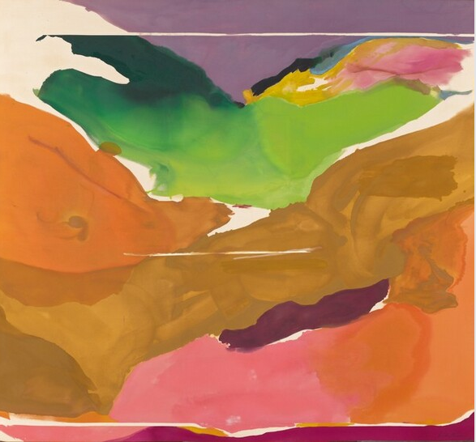
Nature Abhors a Vacuum
1973

Slide 16
A Green Thought in a Green Shade, 1981

Slide 17
Stargazing, 1989

Slide 18
Stella Polaris, 1990

Slide 19
Sandstorm, 1992

Slide 20
Warming Trend
2002

Slide 21
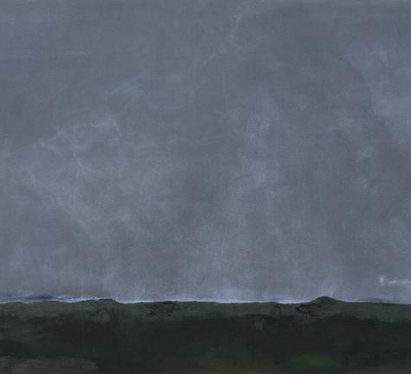
Driving East
2002

Slide 22
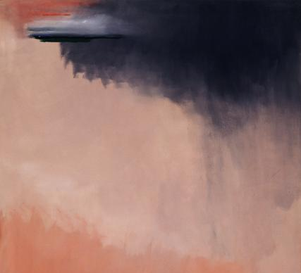
Cloud Burst
2002

Slide 23
Recap Questions:
What do you notice about the colors?
What shapes/forms do you see?
What do each of the paintings make you think of?
How do you feel when you look at her art?

Slide 24
There are no rules... that is how art is born, that is how breakthroughs happen. Go against the rules or ignore the rules, that is what invention is about. - Frankenthaler

