Slide 1
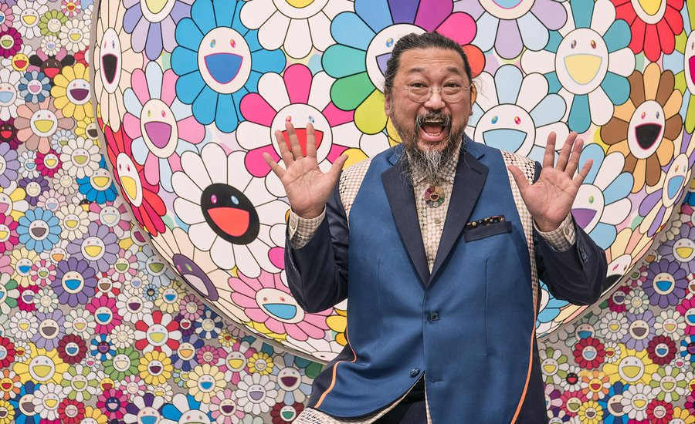
The Vivid World of Takashi Murakami

Slide 2
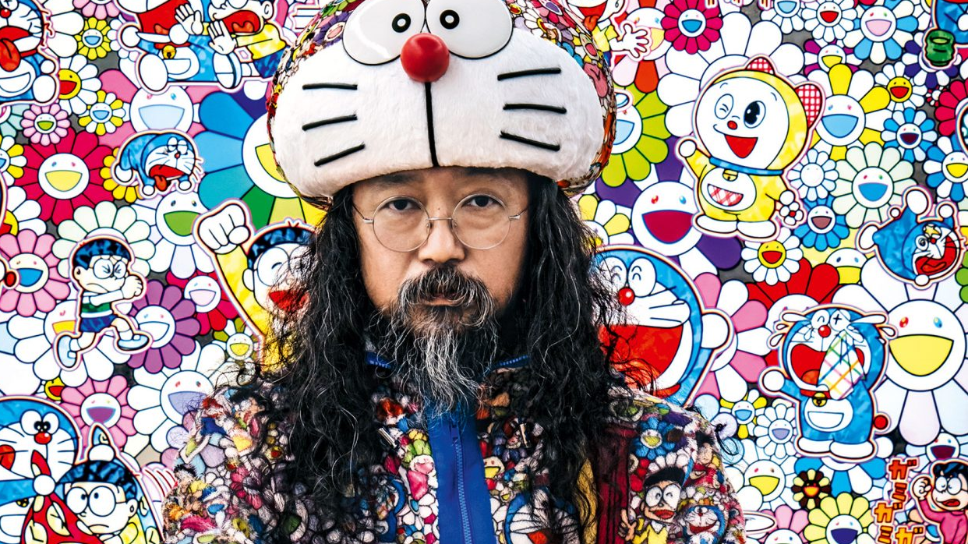
Who is Takashi Murakami?
Let’s find out! https://www.youtube.com/watch?v=pEl6tmfmgxQ

Slide 7
Our group picture will look like

Slide 8
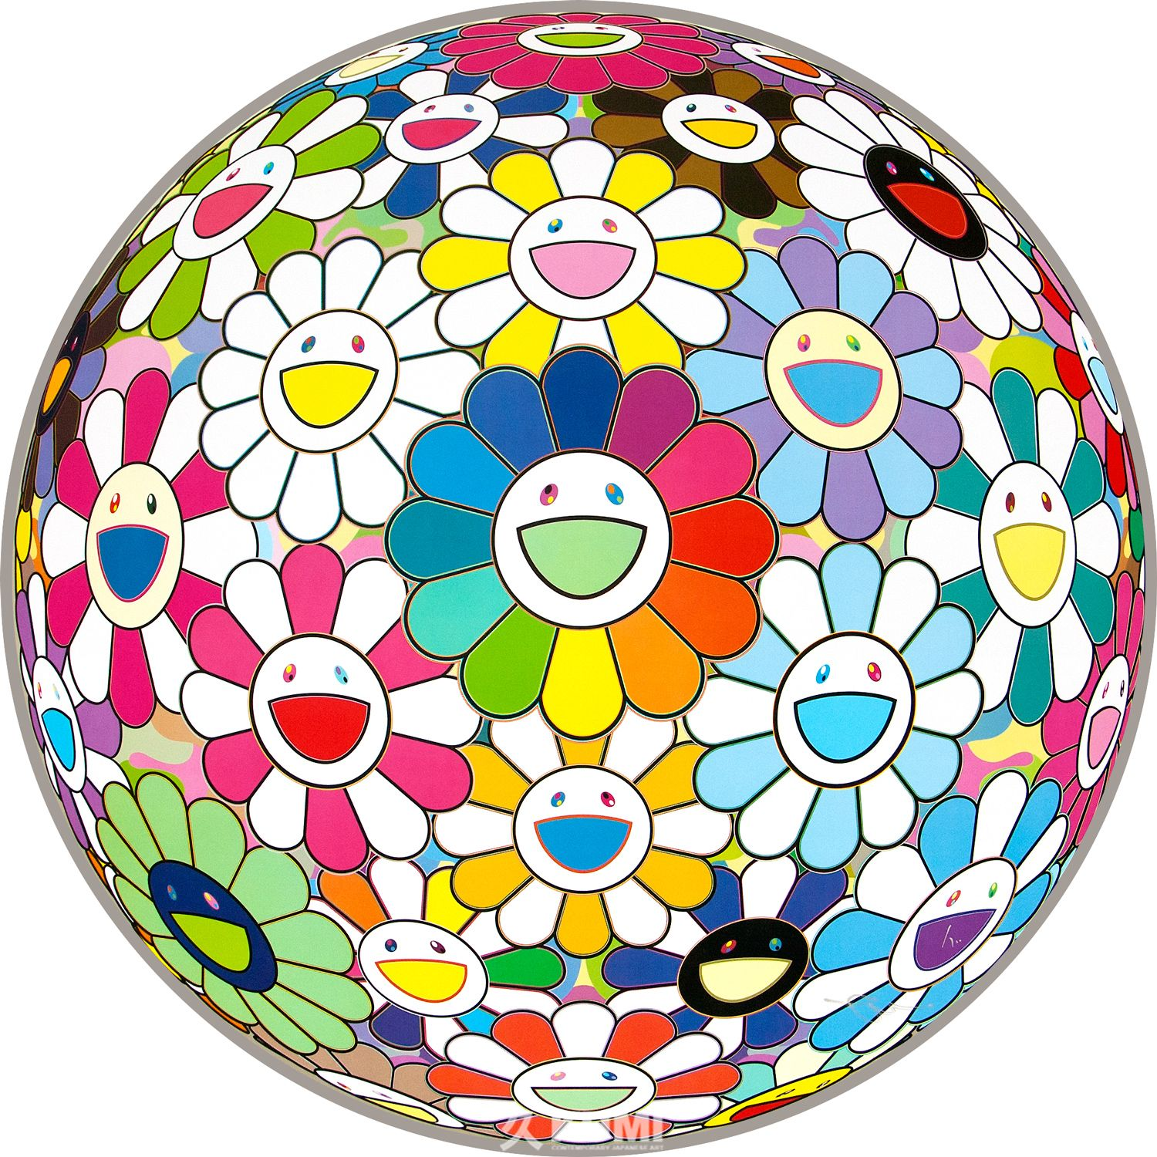
How to draw Murakami flowers
https://www.youtube.com/watch?v=nPPRKty1Uao

